Slide 1






PROMPT ENGINEERING FOR THE PREVENTIVE HEALTH COPILOT
By Sai Krishna Agaram

Slide 2


Objective:
Build an AI Copilot that gives personalized preventive health recommendations using multi-step reasoning and function/tool calling
Key Capabilities:
Handles multi-turn queries (e.g., diet tips, reminders)
Uses function-calling for tools like get_diet_tip() and schedule_reminder()
Optimized through prompt iteration and evaluated using structured metrics

Slide 3
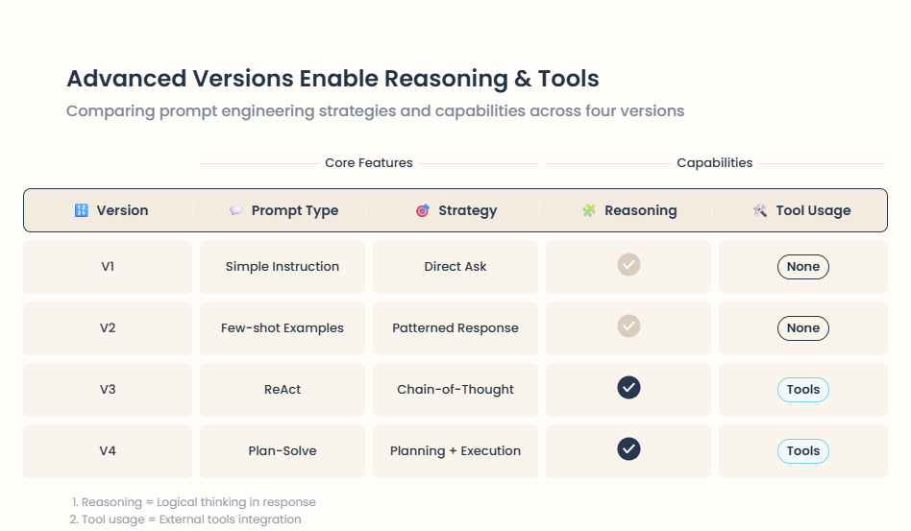
PROMPT STRATEGY AND EVOLUTION

Slide 4
FUNCTION CALLING INTEGRATION
various functions to enhance user interaction, including `get_diet_tip(condition: str) → str`
`schedule_reminder(task: str, date: str) → str`.
Includes additional tools like `health_risk_assessment`, `nutritionix_food API`, `openfoodfacts_nutrition API`, `get_exercise_plan`.

Slide 5
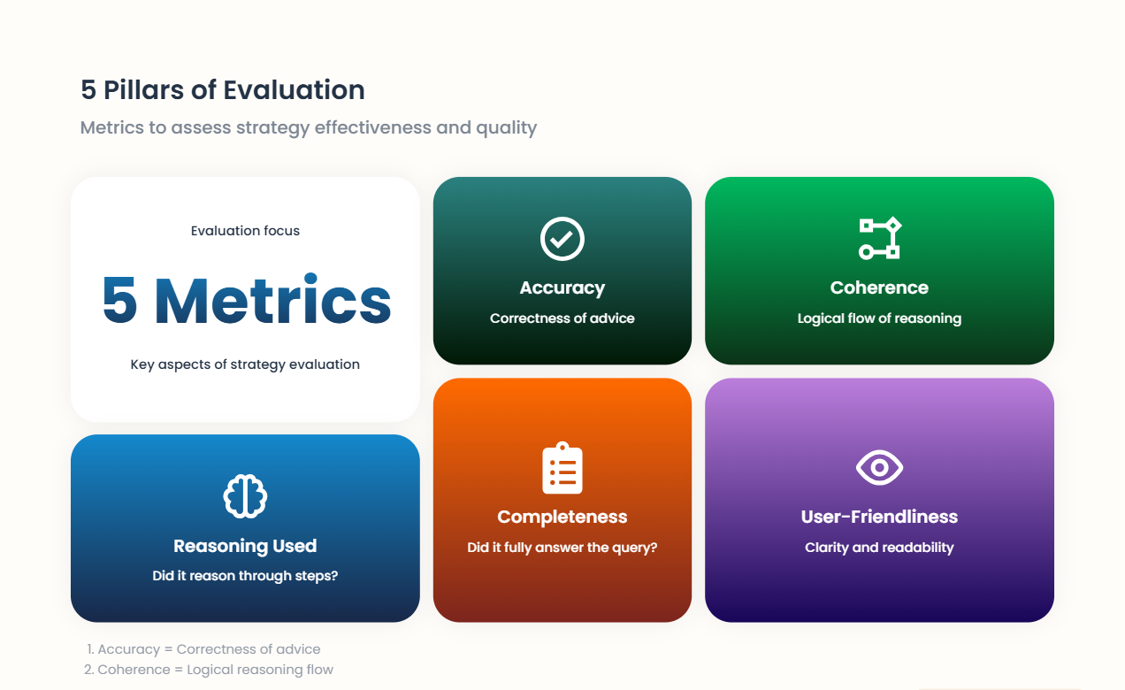
Evaluation Strategy
Scoring: 0–5 based on metric aggregation
Evaluation Tool: score_response() with keyword and tool usage validation

Slide 6
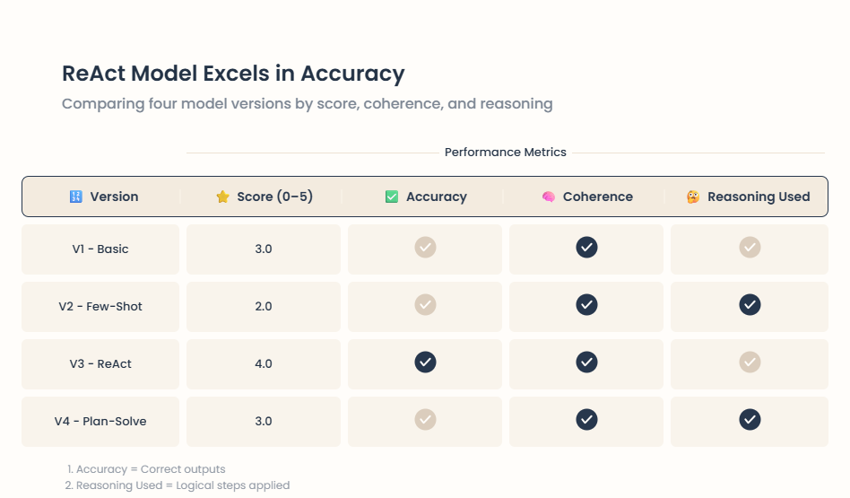
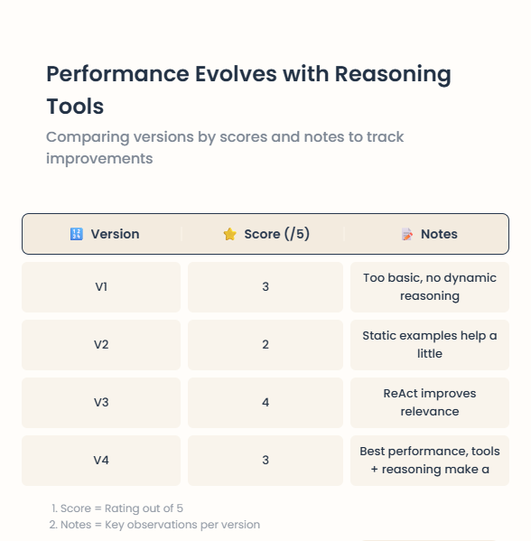
Results & Insights
Insight:
Prompt engineering with Plan-Solve + Tool-Use yields the most reliable and intelligent responses

Slide 7
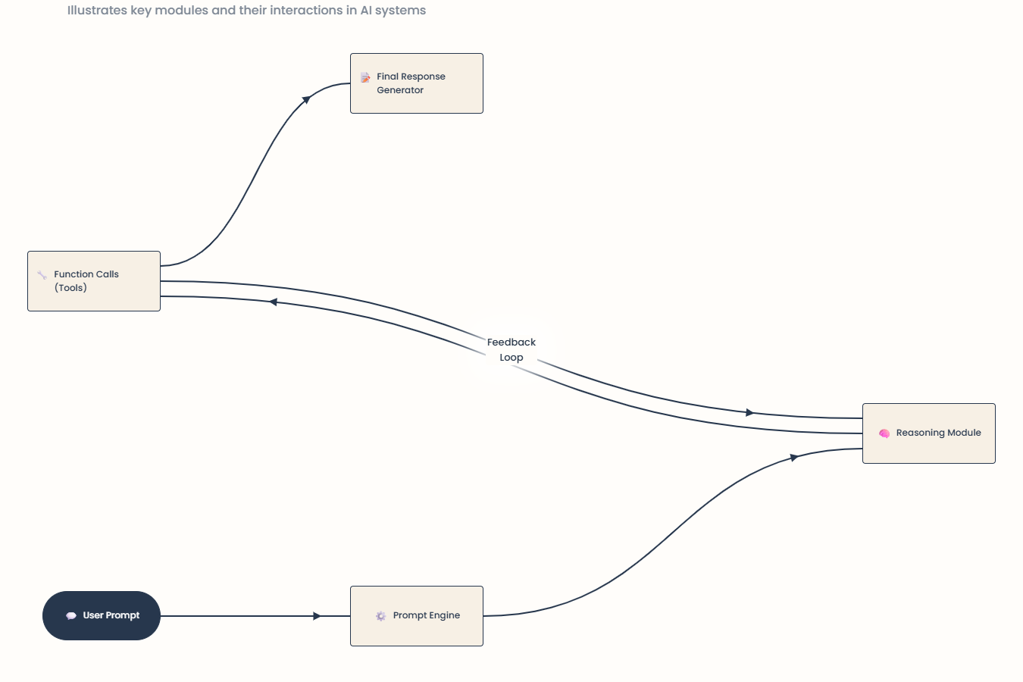
ARCHITECTURE & COMPONENTS
Modular agents using Agno and LLama LLM
Tools exposed via function-calling
Evaluated responses stored for comparison
Deliverables & Repo
Deliverables:
✅ Prompt evaluation notebook with CSV results
✅ Agent + tools integrated in clean Python modules
✅ Streamlit UI (optional)
✅ Slide deck (this)
GitHub Repo Checklist:
https://github.com/Agaramsaikrishna/Health-Copilot.git

Slide 8
THANK
YOU

